Slide 1


Hope to Skills
Lecture# 08
Irfan Malik, Dr. Sheraz Naseer

Slide 2
Agenda
Classification
Sentiment Analysis
What is API
Open.ai API
Key generation
Sentiment Analysis using Open.ai
Blog generation using AI

Slide 3
What is Classification?

Slide 4
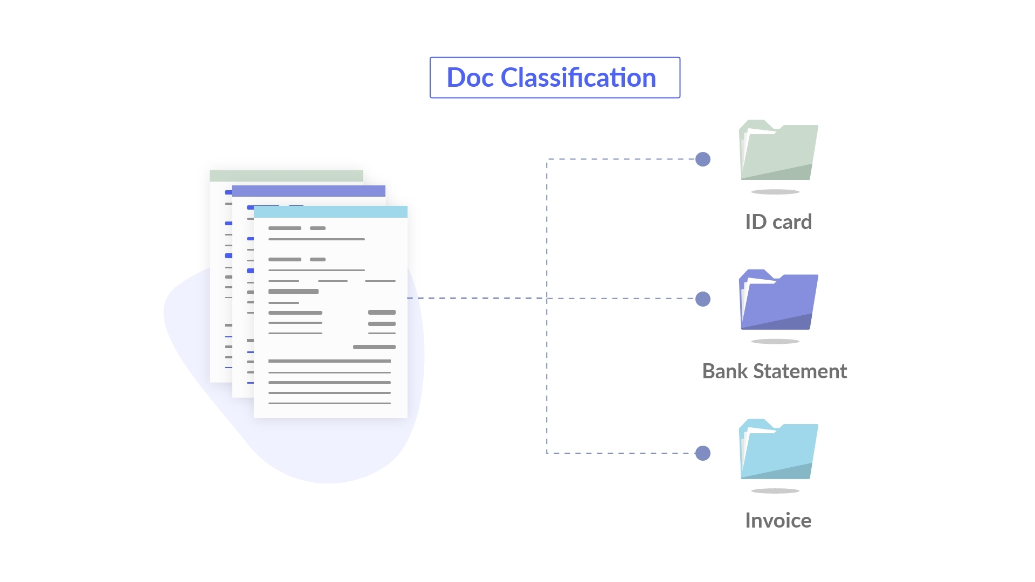
What is Classification?
Classification is a machine learning technique used to categorize data into different classes or categories.
It is a supervised learning approach where the algorithm learns from labeled training data to make predictions or classify new, unseen data.

Slide 5
Applications of Classification
Classification is used in various real-world applications, such as:
Spam email detection
Credit risk assessment
Disease diagnosis
Image recognition
Sentiment analysis (we'll cover this in detail later)

Slide 6
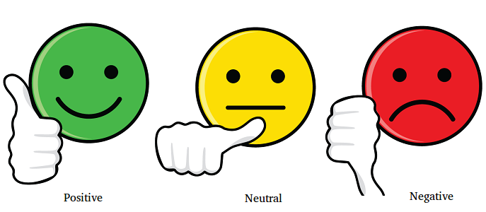
Sentiment Analysis
Sentiment analysis, also known as opinion mining, is a subfield of natural language processing (NLP) that focuses on determining the sentiment or emotional tone of a piece of text.

Slide 7
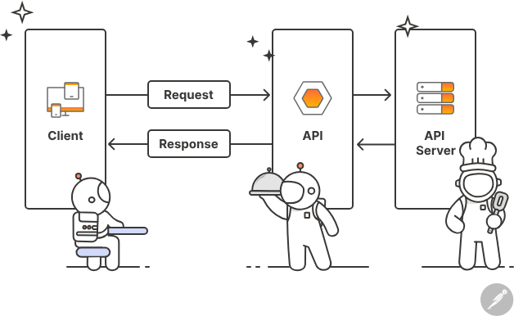
What is an API?
API stands for Application Programming Interface.
It is a set of rules and protocols that allows different software applications to communicate and interact with each other.

Slide 8
Why use APIs?
APIs enable developers to access the functionality of other applications or services without having to understand their internal workings.
They provide a standardized way for applications to exchange data and perform specific tasks.

Slide 9
Types of APIs
There are different types of APIs, including
Web APIs: These are APIs exposed over the web using standard protocols like HTTP, allowing developers to interact with remote services.
Library or Framework APIs: These APIs are provided by libraries or frameworks and offer pre-defined functions and classes to simplify development.
Operating System APIs: These APIs provide access to operating system features and functionalities, allowing developers to interact with the underlying system.

